Slide 1
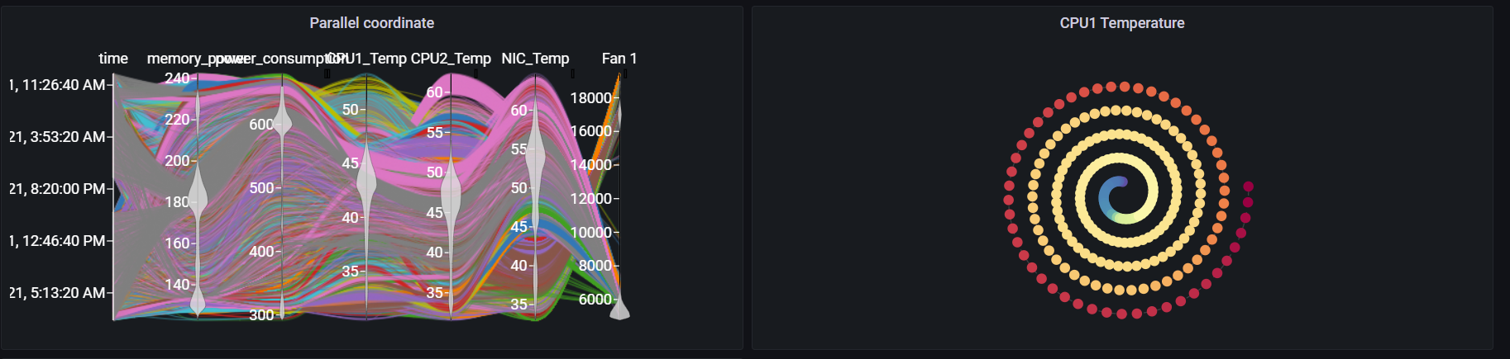
Grafana Plugin
Weekly report

Slide 2
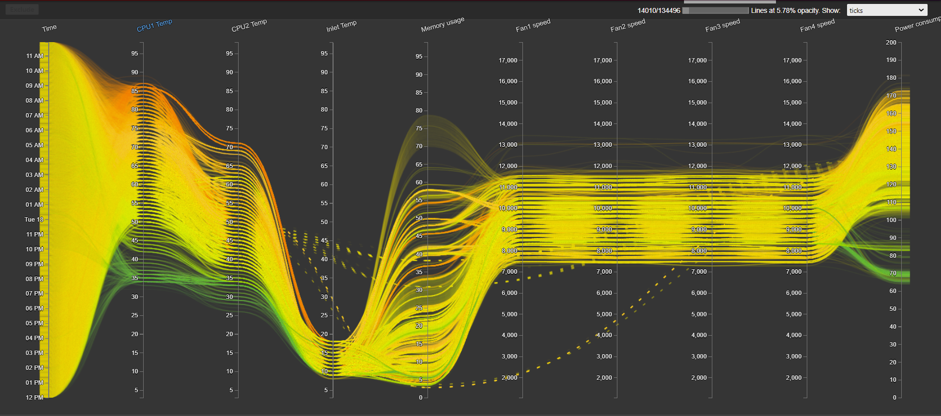
Original visualization
https://idatavisualizationlab.github.io/HPCC/ParallelCoordinates/index.html

Slide 3
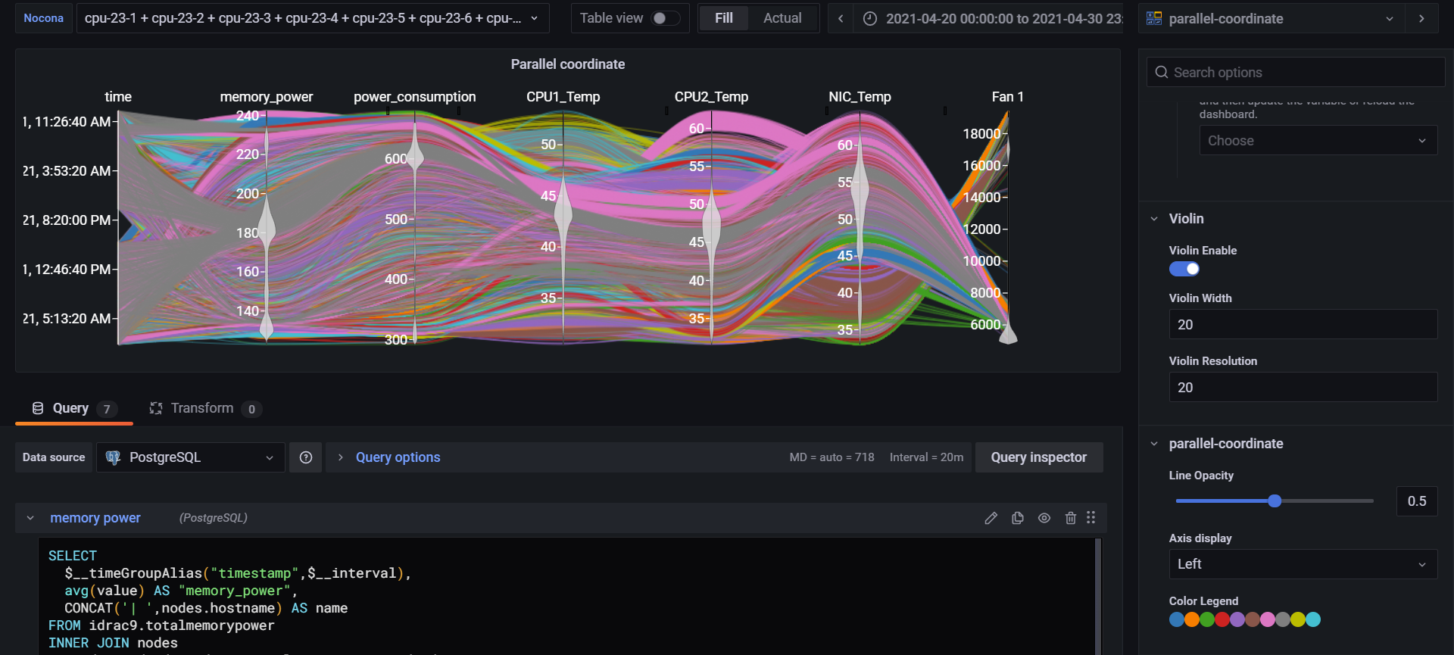
Previous result
Primary app: https://idatavisualizationlab.github.io/HPCC/ParallelCoordinates/index.html

Slide 4
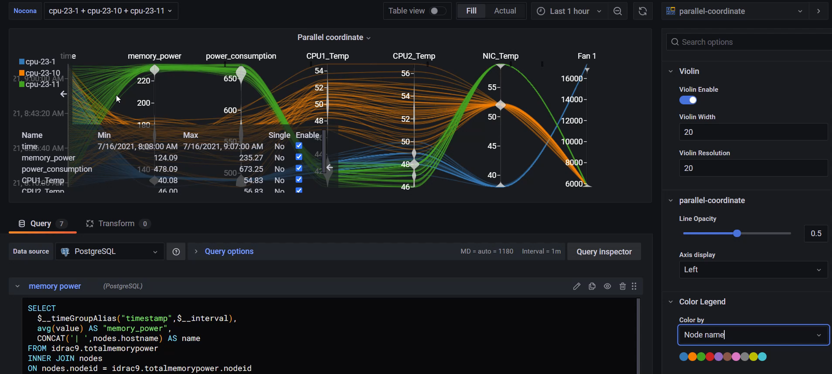
Current result
Primary app: https://idatavisualizationlab.github.io/HPCC/ParallelCoordinates/index.html

Slide 5
Current features
Violin summary on each axis
Show node information when filter
Reformat color legend
Color by Metrics (current color by compute)
Dimension statistic (avoid showing single/ double unique values)

Slide 6
Future features
Rendering by sequences

Slide 7
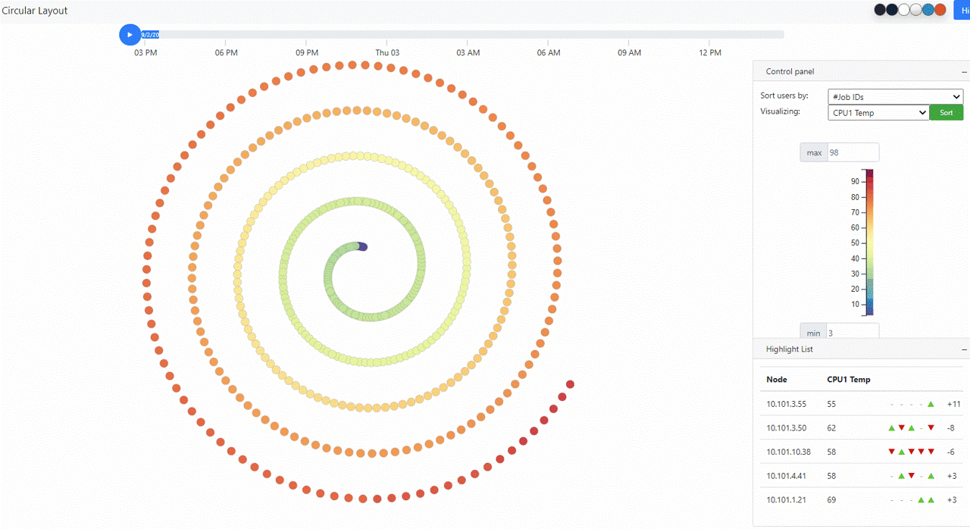
Original visualization
https://idatavisualizationlab.github.io/HPCC/spiralLayout/index.html

Slide 8
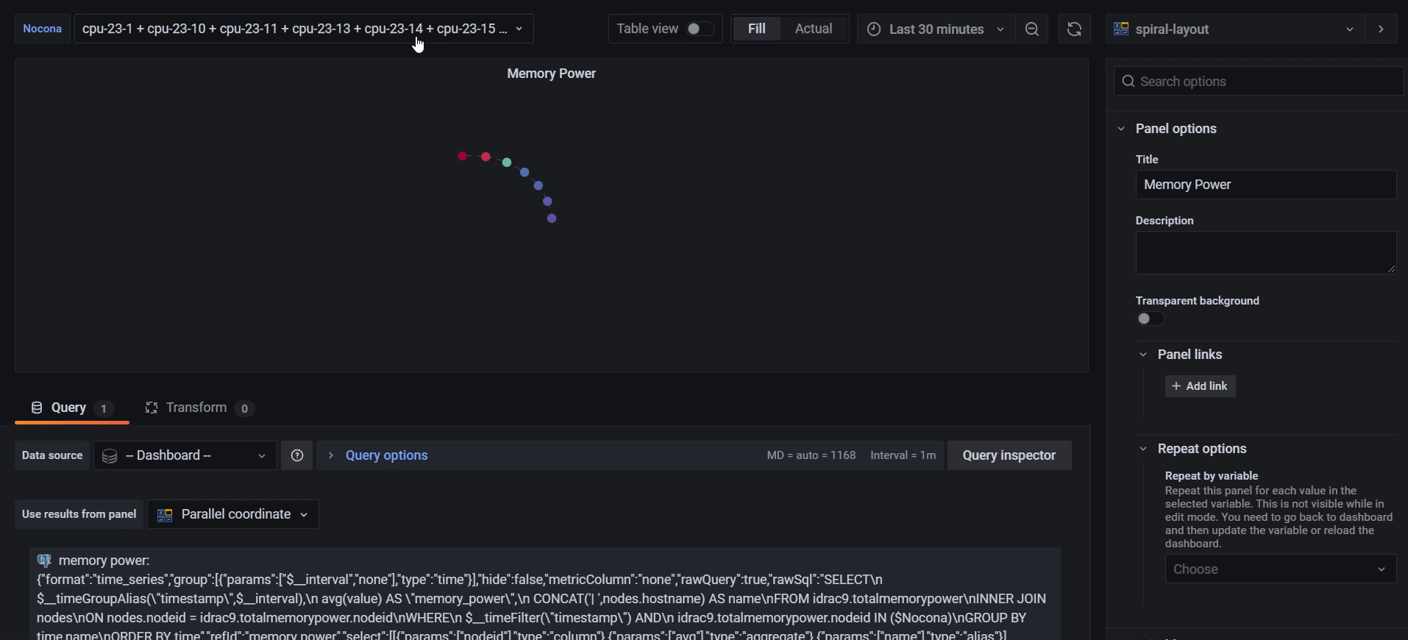
Previous features

Slide 9
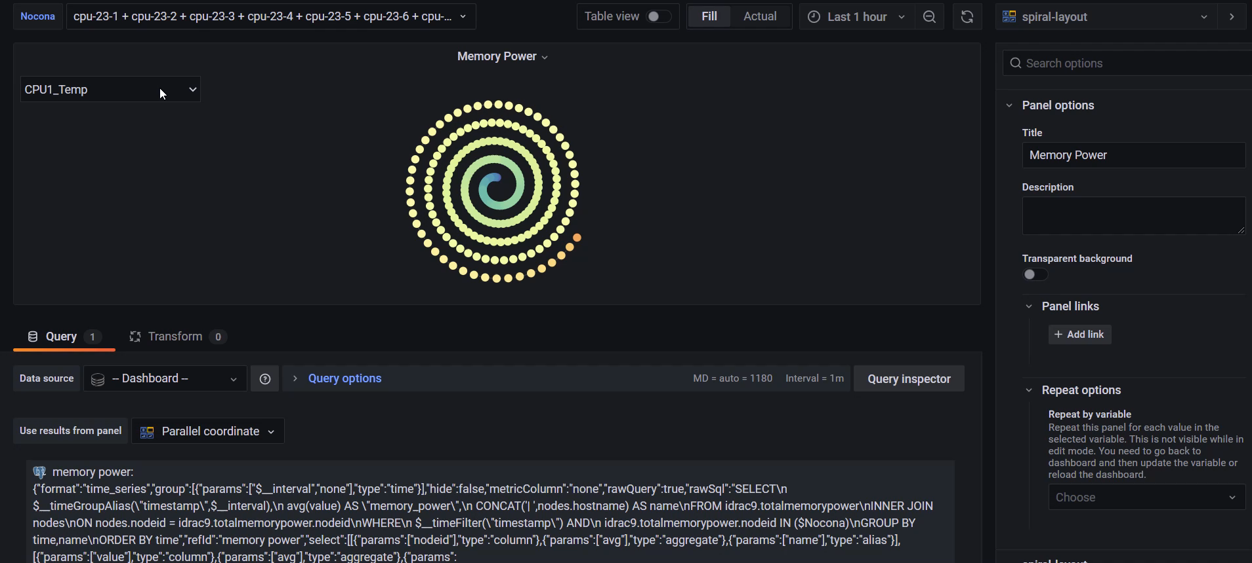
Current features

Slide 10
Current features
Linear scale and None linear scale for spiral layout
Selectable metric
Quick tooltip

Slide 11
Future features
Selectable time range
Trajectory (heatmap)

Slide 12
Job related data
Able to query job data with the query by time and running node:
SELECT *FROM slurm.jobsWHERE start_time < ${__to:date:seconds} AND end_time BETWEEN ${__from:date:seconds} and ${__to:date:seconds} AND ARRAY[${Nocona:csv}] && nodes

Slide 13
Challengs
Not figure out where is the Job information locates in DELL database
Transfer code from javascript to Typescript take time

